Slide 1
How Old is Earth?
How do We Know?
July 31, 2012
Presented to teachers in TRUST
by Denton S. Ebel
Curator, Meteorites
Department of Earth and Planetary Sciences

Slide 2
Historical age determinations.
Review of geologic time.
Radiogenic isotope dating.
Earth in a solar system context.

Slide 3
Age Determination
Pre-requisite: Concept of Time
Faith - based: Vedas, Bible, other traditions
Science - based: Relative age
Absolute age
Age of Earth: Oldest solar system solids
are 4.567 billion years old

Slide 4
Plato reports a cyclicity of time, repeating at about 72,000 years
A variation: amongst some Hindu texts, Earth began with the birth of Brahma, ~ 4.3 billion years ago.
Western religions… time is linear, it has a beginning and an end. Thus a ‘start time’ exists.
Judaic tradition: it all started in 3760 BCE.

Slide 5
Kepler (1571-1630) ~3993 BCE, based on Biblical scripture.
Newton (1643-1727) ~3998 BCE, based on Biblical scripture
Later, in 1650, James Ussher, Anglican Archbishop of Ireland, reported ~4004 BC, based on Biblical scripture.
Edmund Halley (1656-1742) said the earth must be much older, assuming the oceans were initially fresh and the salt washed in by land erosion… that would take a longer time

Slide 6
Compte d’Buffon (1707-1788): Earth is 74,652 years old, based on scaling the time it took to cool hot iron spheres. This was apparently the first attempt at employing experimental methods to get a fix on the age of the earth (The thermal conductivity of rocks is about 1/50 that of iron which would imply nearly 3.5 million years instead)
Hutton (1726 – 1797) was the first great geologist to note that erosion and mountain building must take millions of years. This is relative dating.
Relative Dating (A is older than B)
Absolute Dating (A is 10 years old)

Slide 7
Charles Lyell (1797-1875) introduced
‘stratigraphic ages’: The lower layers of sedimentary rocks must be older that the layers overlying them. He concluded that the age of the earth must be millions of years.
Principle #1: original horizontality: sedimentary layers (beds) are laid down nearly flat; if they are not flat, they were later disrupted by folding or faulting.
Principle #2: superposition: Rock layers on the bottom are older than rock layers on the top

Slide 8
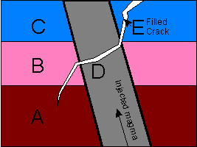
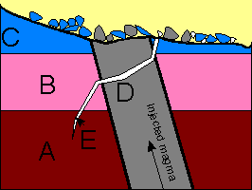
Principle #3: cross-cutting relationships: A rock is older than anything that cuts it, including fractures.
Principle #4: inclusions: Rock particles are older than the rocks that include them. The yellowish upper rock is younger than the blue/gray pieces within in it.

Slide 9
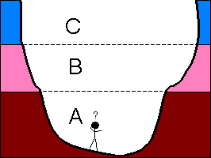

Principle #5: lateral continuity: Sedimentary layers are laterally continuous, so you can connect beds across gaps: between canyon walls, across covered areas , and underground.
Principle #6: faunal succession: Species begin and end. If sedimentary rocks contain the same fossils, then they were deposited in the same time interval.

Slide 10
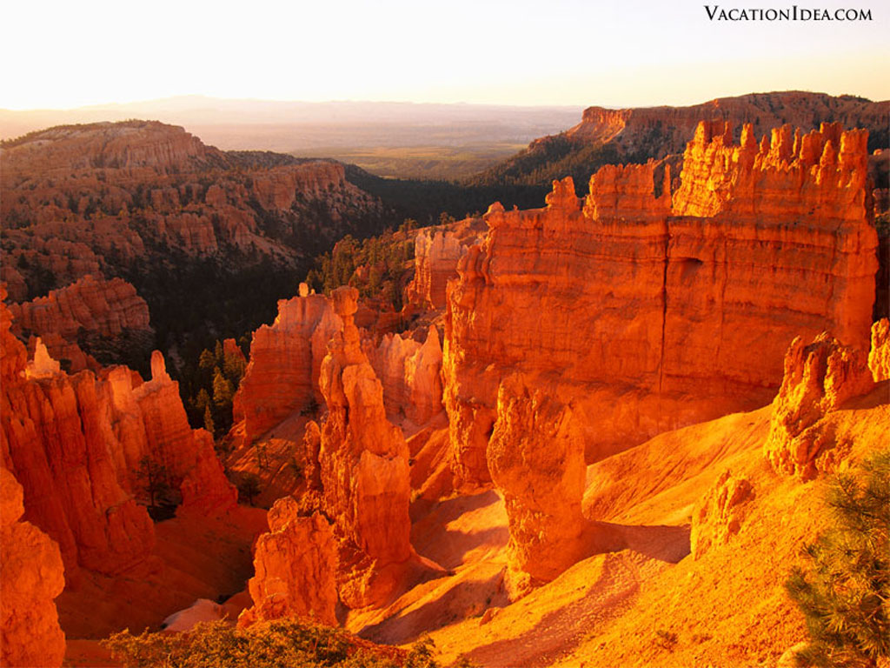
Bryce Canyon, Utah

Slide 11
Lord Kelvin (of the Kelvin temperature scale, 1842-1907) introduced physics to the problem. He solved the heat equation for a cooling conducting sphere, concluding Earth is 25 million years old.
Joly (1857–1933) noted that radioactive elements generate internal heat, upping the age to 90 million years. But then Earth’s interior would melt every 30 million years! He then proposed mantle convection, continental motion, volcanism, mountain building ... explaining ‘orogenies’, periods of massive surface changes on the Earth.
Notes:
Joly later modified his views, taking into account that if heat were transported from the interior of the earth by conduction alone, it would melt about every 30 million years. He proposed, then the first hint of mantle convection… the interior of the earth melted every 30 million years, leading to the continents sliding around, extensive volcanism, mountain building… all this offered an explanation for ‘orogenies’, periods in which the earth underwent massive surface changes

Slide 12
Sir Harold Jeffreys (1891-1989) a prominent geophysicist, ridiculed Joly’s views, stating that Joly managed to get his science published solely because Joly was the editor of a scientific journal. Sir Harold was also adamant that continents did NOT drift and that the earth’s mantle did NOT convect. He stuck to his views until his death .
Continental drift was theorized by Alfred Wegener (1880-1930). The role of seafloor spreading, the foundation for modern plate tectonic theory, was established in the 1960s by Harry Hess (1906-1969). It was confirmed by magnetic surveys of the sea floor.

Slide 13
Review of geologic time.

Slide 14
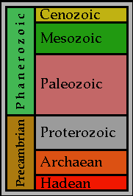

Slide 15
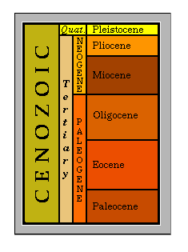
Notes:
This series may have errors. The “Tertiary” was removed in the early 2000’s.

Slide 16
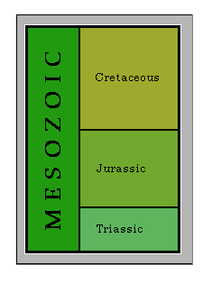
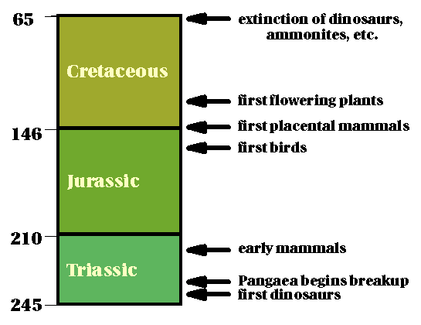

Slide 17
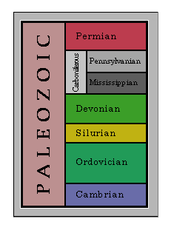
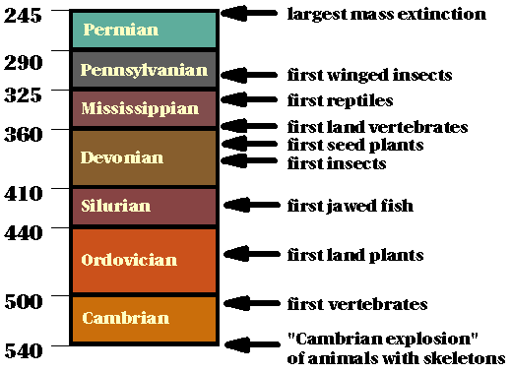

Slide 18
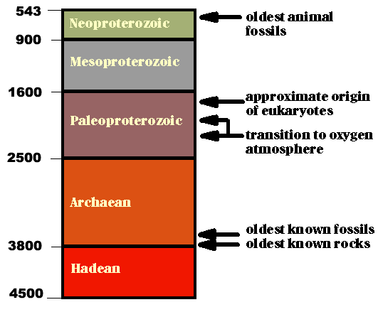
The Precambrian

Slide 19
Radiogenic isotope dating.
American geochemist Clair Cameron Patterson (1922-1995) pioneered uranium–lead radiometric dating methods. He used the lead-lead method to obtain one of the earliest (1956) accurate measurements of the age of the Earth (4.55 Ga) from the Canyon Diablo meteorite.

Slide 20
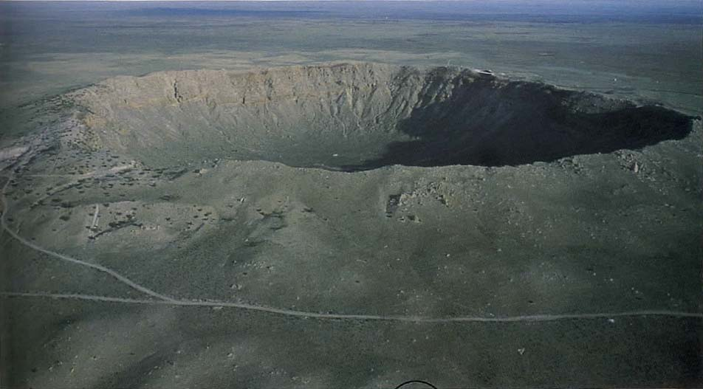
Barringer (Meteor) Crater, Arizona
about 1 kilometer (0.6 mile) wide, formed 50,000 years ago
estimated diameter of Canyon Diablo meteorite: 100 feet

Slide 21
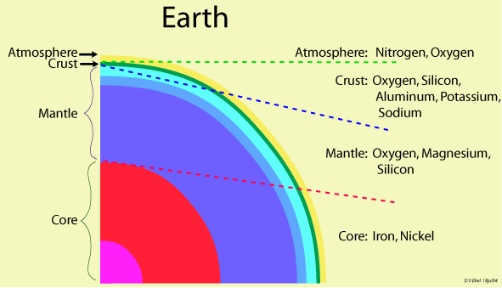

Slide 22
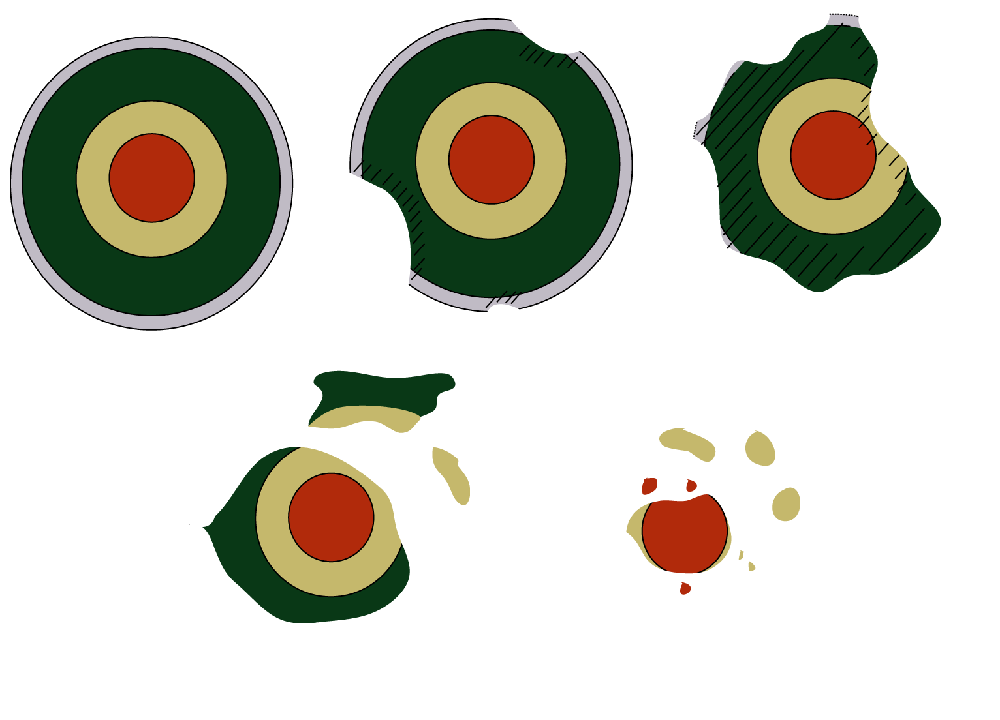
1
2
3
4
5
Collisions fragmented early planets, exposing iron cores.
Notes:
Collisions..... No one ever documented as being killed by a meteorite.

Slide 23
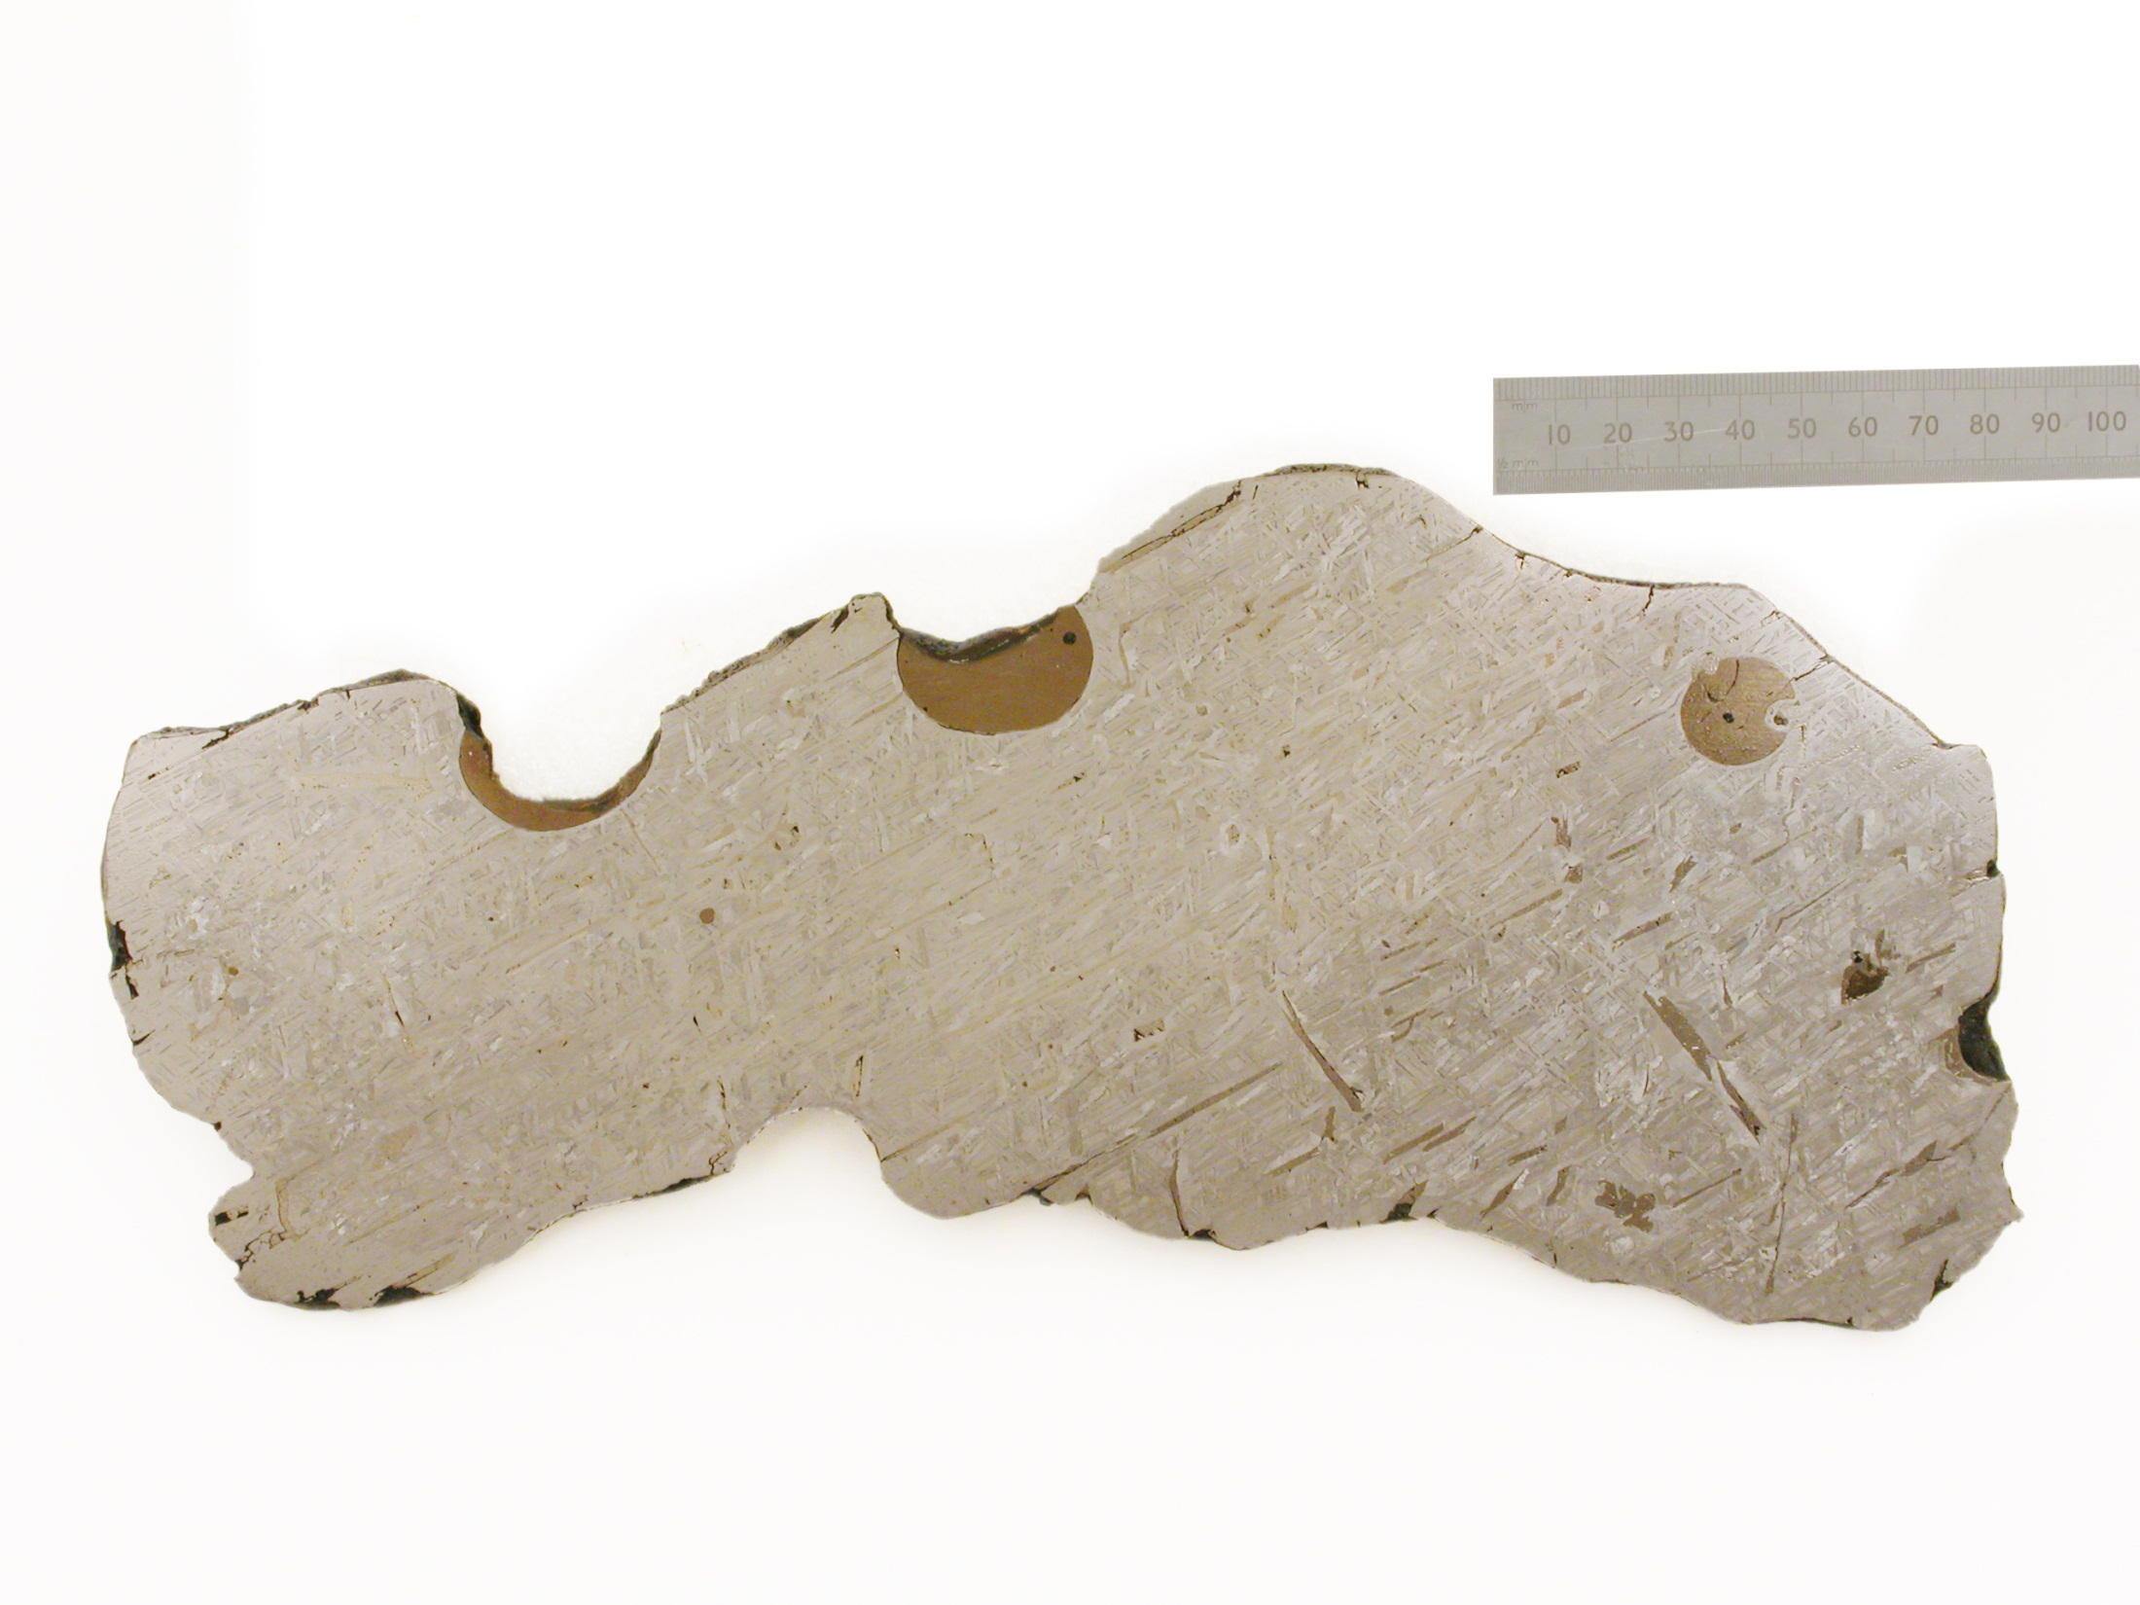
Bella Roca
Durango, Mexico
found 1888
Iron Meteorite

Slide 24
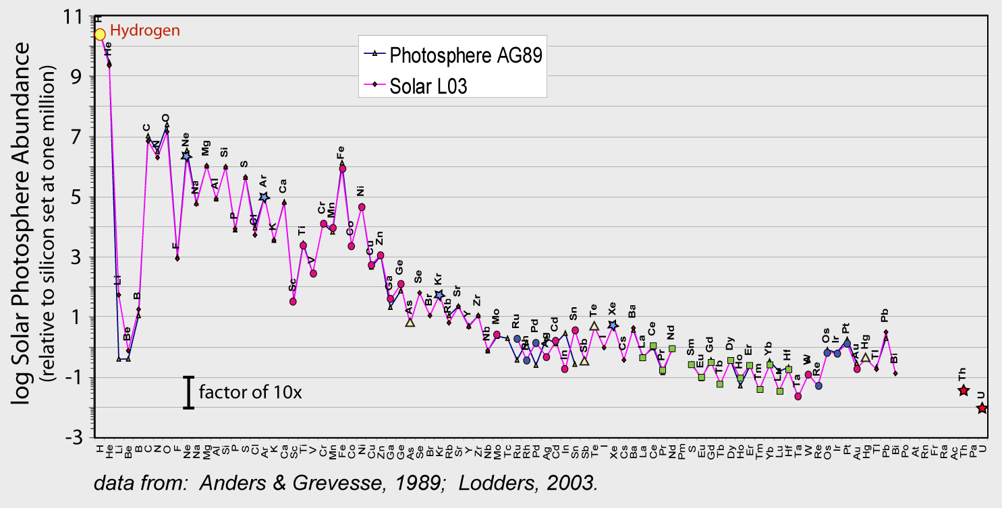
Notes:
24

Slide 25
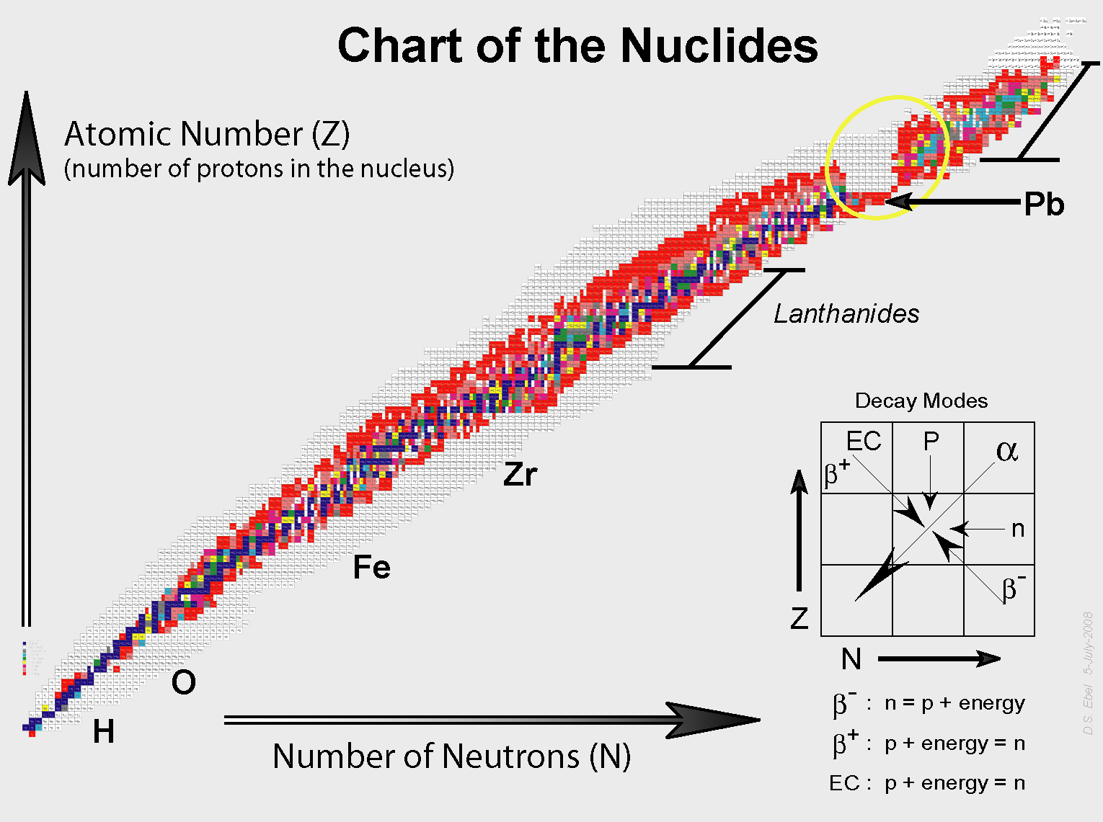
Notes:
Source: D.S. Ebel (photo of product)
See also:
http://atom.kaeri.re.kr/
http://www.nndc.bnl.gov/chart/ (interactive)

Slide 26
radioactive elements decay exponentially according to the formula
A = A_{o}e ^{-λt}
Where A is the remaining amount of the element
A_{o} is the initial amount of the element
λ is the rate of decay, the “decay constant”
e = base of the natural logarithms = 2.71828
t = time that the element has decayed
Note: Decay rates are independent of temperature, pressure, and other physical-chemical conditions.

Slide 27
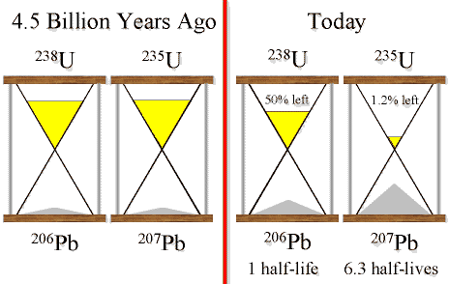
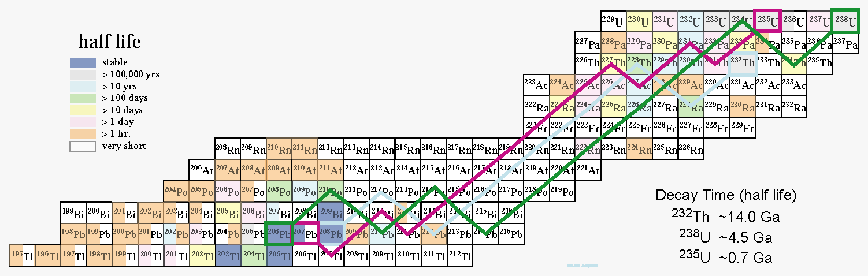
Notes:
See GCA by Allegre etc. GCA 59: 1445 (1995)

Slide 28
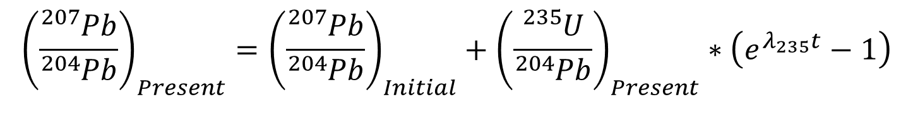
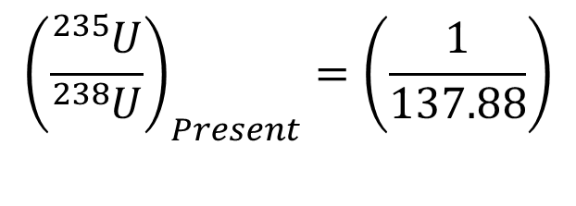
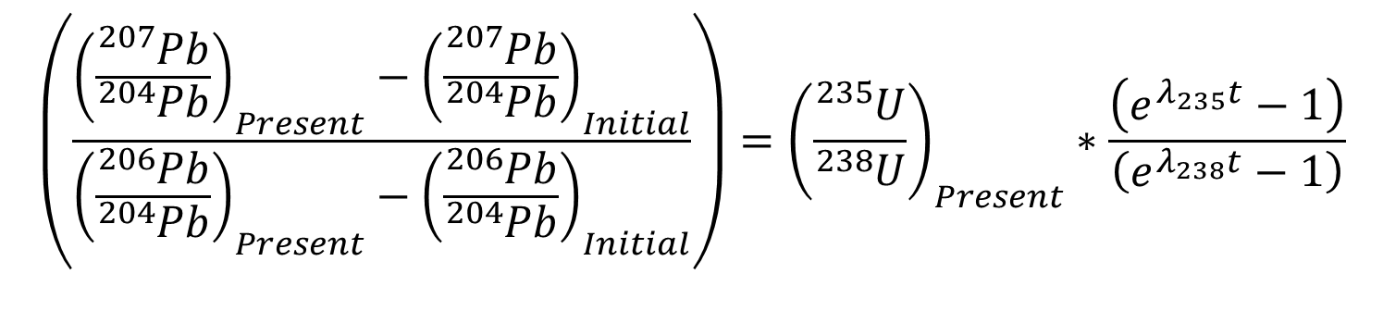
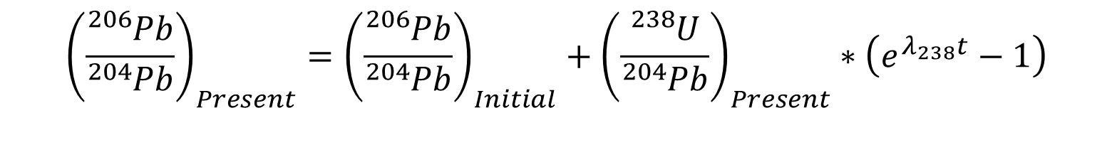
Lead-Lead Dating
$${\left(\frac{{}_{}^{207}{Pb}}{{}_{}^{204}{Pb}}\right)}_{Present}={\left(\frac{{}_{}^{207}{Pb}}{{}_{}^{204}{Pb}}\right)}_{Initial}+{\left(\frac{{}_{}^{235}U}{{}_{}^{204}{Pb}}\right)}_{Present}∗\left(e^{λ_{235}t}−1\right)$$
$${\left(\frac{{}_{}^{206}{Pb}}{{}_{}^{204}{Pb}}\right)}_{Present}={\left(\frac{{}_{}^{206}{Pb}}{{}_{}^{204}{Pb}}\right)}_{Initial}+{\left(\frac{{}_{}^{238}U}{{}_{}^{204}{Pb}}\right)}_{Present}∗\left(e^{λ_{238}t}−1\right)$$
$$\left(\frac{{\left(\frac{{}_{}^{207}{Pb}}{{}_{}^{204}{Pb}}\right)}_{Present}−{\left(\frac{{}_{}^{207}{Pb}}{{}_{}^{204}{Pb}}\right)}_{Initial}}{{\left(\frac{{}_{}^{206}{Pb}}{{}_{}^{204}{Pb}}\right)}_{Present}−{\left(\frac{{}_{}^{206}{Pb}}{{}_{}^{204}{Pb}}\right)}_{Initial}}\right)={\left(\frac{{}_{}^{235}U}{{}_{}^{238}U}\right)}_{Present}∗\frac{\left(e^{λ_{235}t}−1\right)}{\left(e^{λ_{238}t}−1\right)}$$
Decay Constants
λ₂₃₈ = 1.55 x 10⁻¹⁰
λ₂₃₅ = 9.85 x 10⁻¹⁰
$${\left(\frac{{}_{}^{235}U}{{}_{}^{238}U}\right)}_{Present}=\left(\frac{1}{137.88}\right)$$
Notes:
Divide equation 1 by equation 2.
Hydrogen has only one proton, hence does not need a neutron to keep its nucleus together. Helium, the next element up the periodic table, does. The stable isotope of helium requires the combined nuclear force of two neutrons to keep its two protons from flying apart. ²³⁸U with 92 protons requires 146 neutrons to hold it together and even then, ²³⁸U still comes apart, with a half-life of 4.47 billion years.

Slide 29
Lead - Lead Geochron Diagram
“mu” = (²³⁸U/²⁰⁶Pb)_{present}
-----------------------
Canyon Diablo Troilite:
207/204 = 10.293
206/204 = 9.3066
(Chen + Wasserburg, 1983)
Notes:
Work-U-Pb.xls (DSE) Isochron is 2.07e+9 Ga (years ago) initial = 4.568 Ga.
Faure's "mu“ of 10 = 238/206 present day
Initial 207/204 Pb CDT: 10.293
Initial 206/204 Pb CDT: 9.3066 Faure p.313, from Chen & Wasserburg (1983)
Equation 1: (207Pb/204Pb)present = (207/204Pb)initial + (235U/204Pb)present * ( e^(lambda*AgeOfEarth) - e^(lambda*timeSampleIsolated))

Slide 30
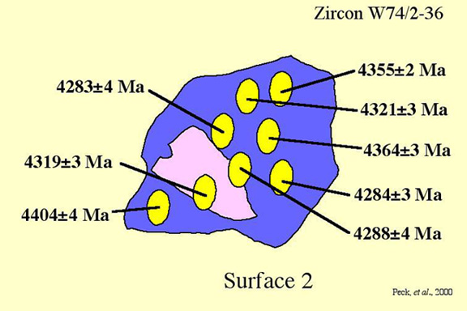
Uranium - Lead Dating
²⁰⁶Pb* / ²³⁸U = e ^{-λ238 t} - 1, where λ₂₃₈ = 1.55 x 10⁻¹⁰
²⁰⁷Pb* / ²³⁵U = e ^{-λ235 t} - 1, where λ₂₃₅ = 9.85 x 10⁻¹⁰
Requires a closed system (no loss of Pb).
e.g., zircons (retain lead below about 900°C
Requires high-resolution.
SIMS or LA-ICPMS
Notes:
lambda (238U) = 1.5512548E-10
lambda (235U) = 9.8484986E-10
JackHills-22-ages.jpg

Slide 31
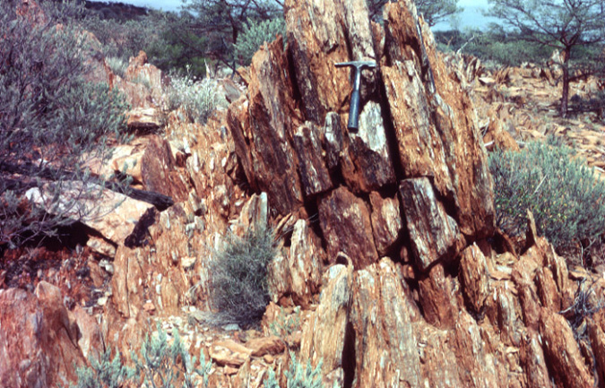
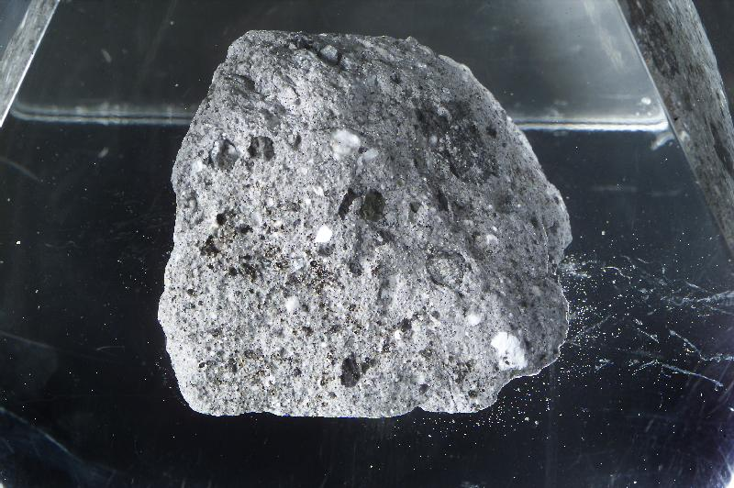
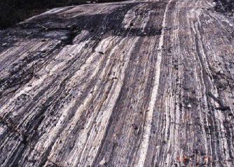
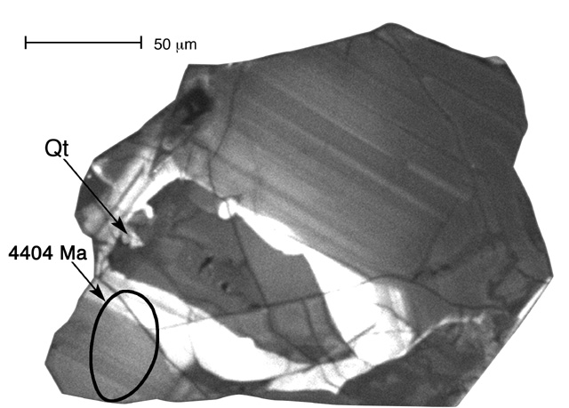
Oldest rocks on Earth
Oldest rocks from the Moon
~3.06 Ga
~4.5 Ga
Jack Hills metaconglomerate, Australia
~4.03 Ga
Lunar Highlands rock (Apollo 16)
Oldest mineral formed on Earth
Acasta gneiss, Canada
Jack Hills zircon: 4.404 Ga
Notes:
http://www.geology.wisc.edu/zircon/zircon_home.html
3060 Ma is the age of the youngest detrital zircon in the Jack Hills rock (metamorphosed sandstone conglomerate).
Analyses of zircons from a felsic Acasta orthogneiss with presumed granitic protolith returned an age of 4.031 ± 0.003 Ga
For Acasta see Iizuka et al. Precambrian Research 153 (2007) 179–208

Slide 32
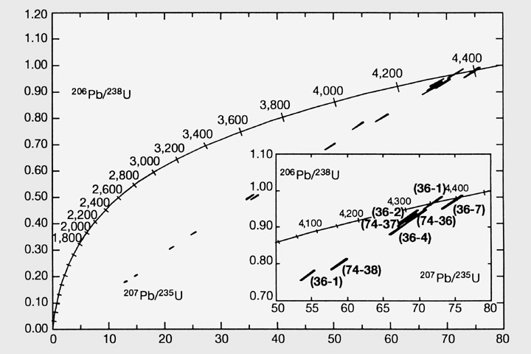
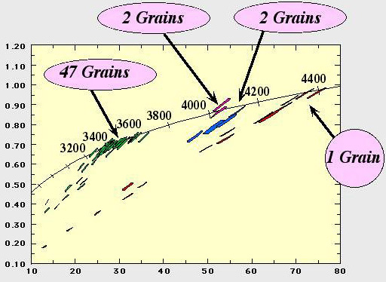
U-Pb Concordia Diagram for Detrital Jack Hills Zircons
²⁰⁶Pb*/²³⁸U
²⁰⁷Pb*/²³⁵U
Notes:
JackHills-6-concordia.jpg (just one grain) JackHills-14-Concordia2.jpg (with color)
14. U-Pb Concordia for zircons from sample W74 with ages from 3.3 to 4.4 Ga. (Peck et al. 2000, 2001)

Slide 33
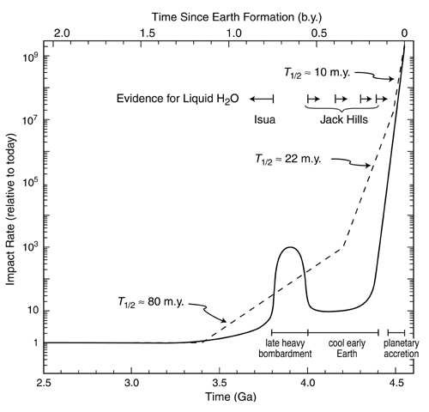
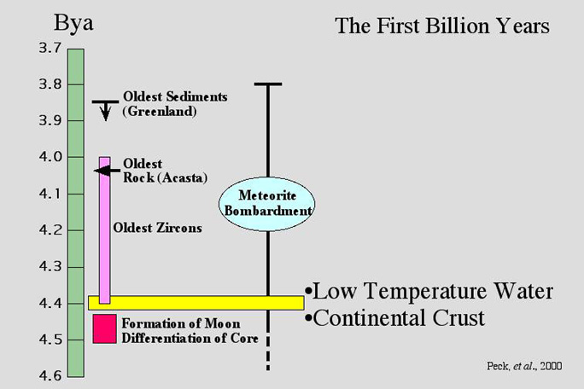
Hypothesis for LHB on a
cool, wet early Earth
from Valley et al. (2002):
Notes:
JackHills-27-OldestRockTimeline.jpg and JackHills-31-LHBgraph.jpg from U Wisc SIMS site.
31. Estimates of meteorite impact rate for first two billion years of Earth history. Two hypotheses are shown: exponential decay of impact rate (dashes, and a cool early Earth/ late heavy bombardment (solid curve, this study). In either model, spikes occurred owing to isolated large impacts. Evidence for liquid water comes from high-d18O zircons (>4.4 Ga to >4.0 Ga) and sedimentary rocks (Isua 3.8-3.6 Ga). The cool early Earth hypothesis (solid curve) suggests that impact rates had dropped precipitously by 4.4 Ga, consistent with relatively cool conditions and liquid water on the surface of the Earth. (Valley et al. 2002)
xxx

Slide 34
Earth in a solar system context.

Slide 35
Clouds of Gas and Dust
Telescope Observations
Theoretical Calculations
Origin of the Elements

Slide 36
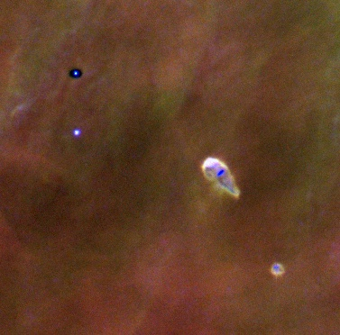
Accretion Disks in the Orion Nebula

Slide 37

A nebula forming systems like our own, viewed in three dimensions

Slide 38
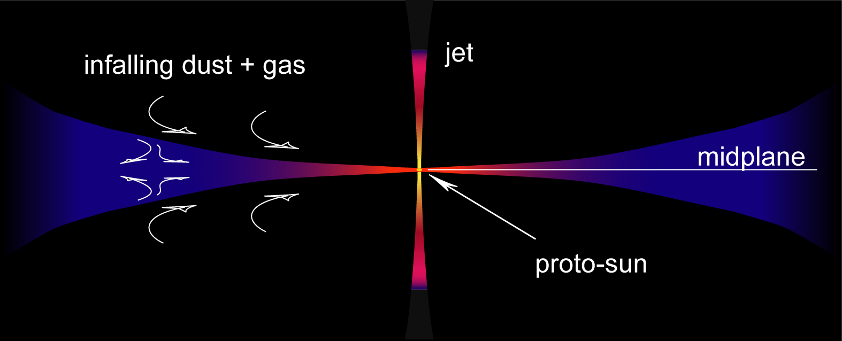
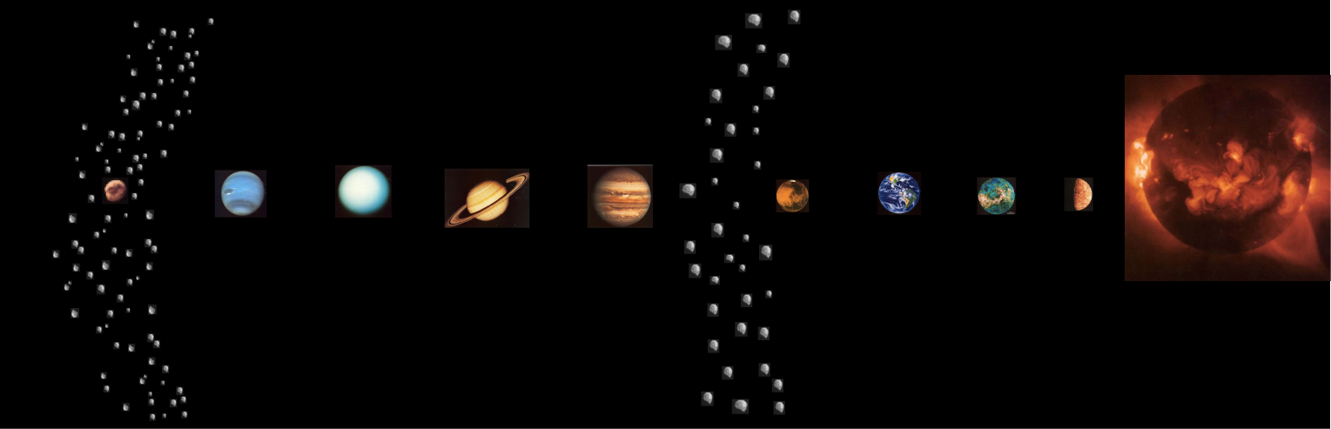
Protoplanetary Disk
...about four and a half billion years later...
SUN
comets
asteroids > meteorites
asteroids

Slide 39
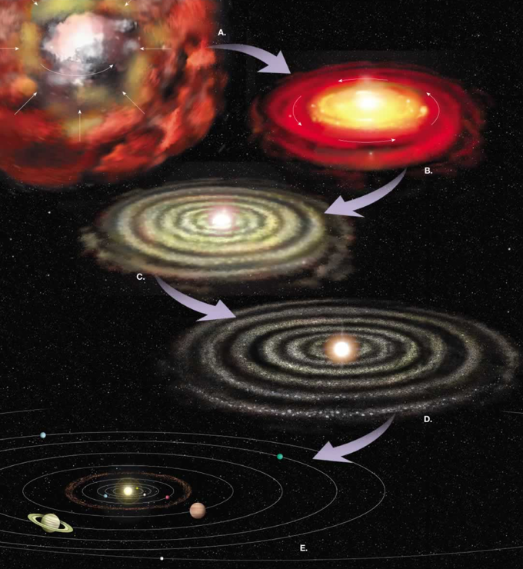
Evolution of solar nebula toward planet formation
Notes:
39

Slide 40
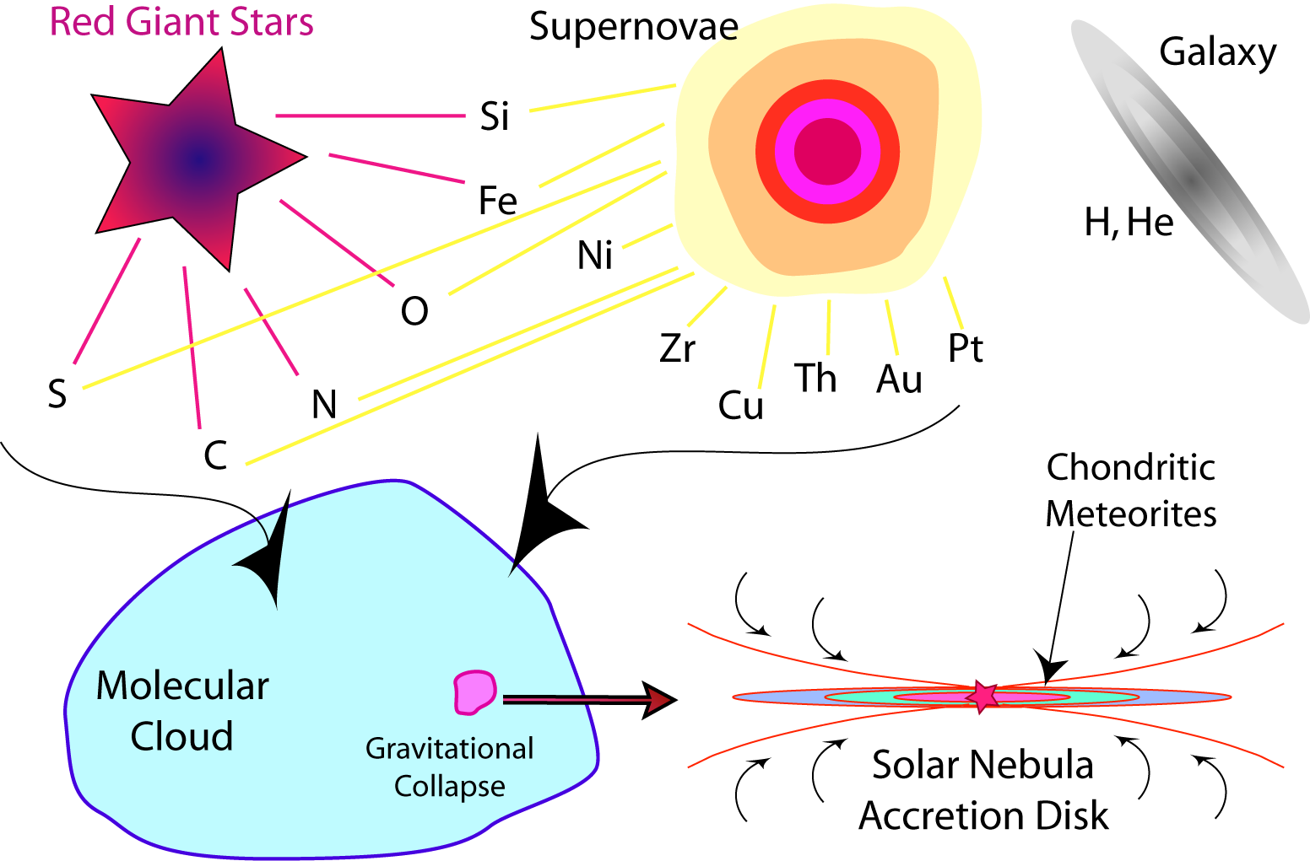

Slide 41
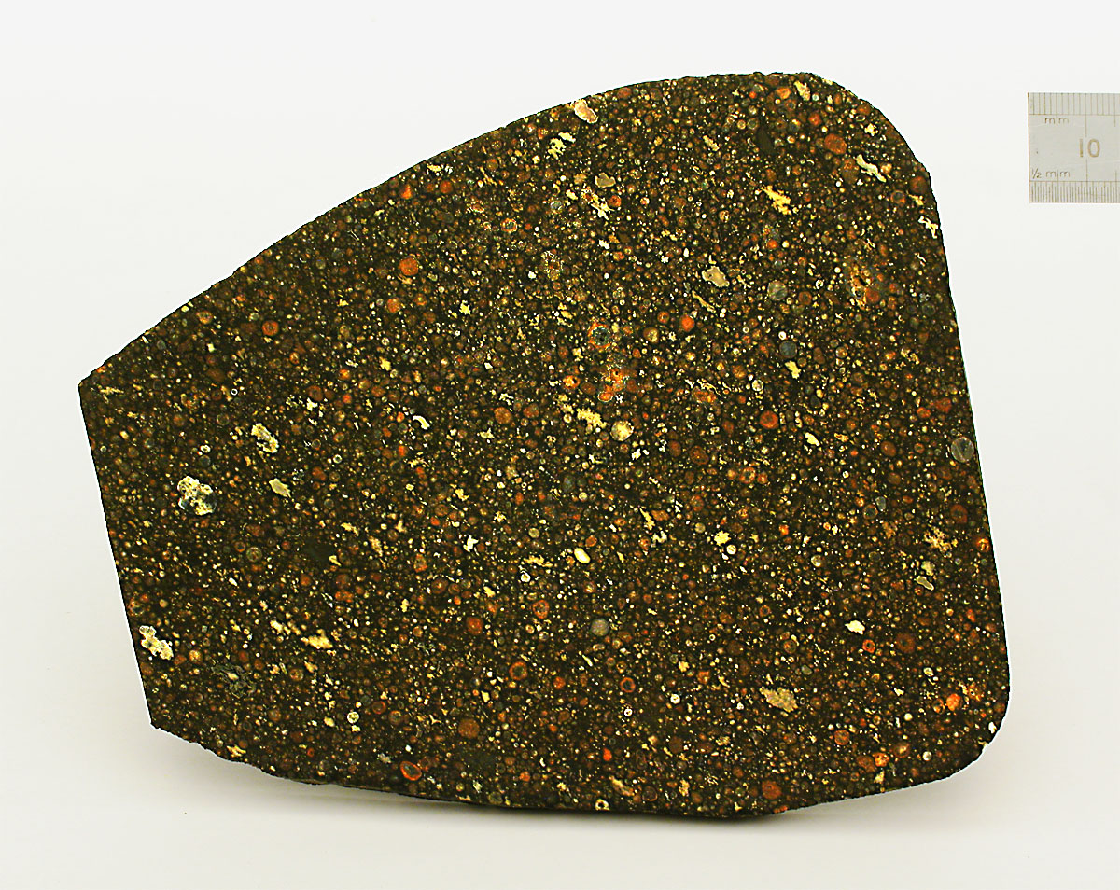
The Evidence
chondrules
Ca-, Al-rich
inclusions
Axtell (CV3)
McLennon County, Texas
found 1943

Slide 42
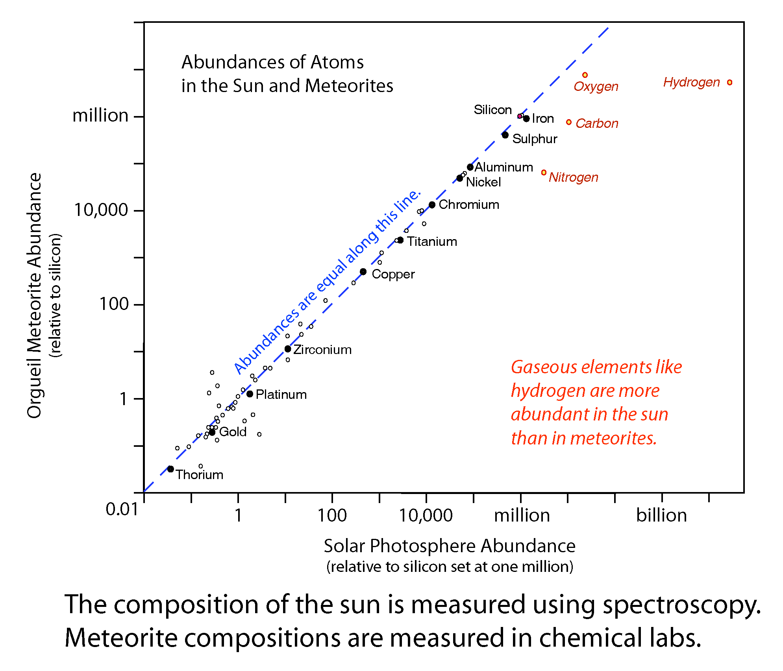

Slide 43
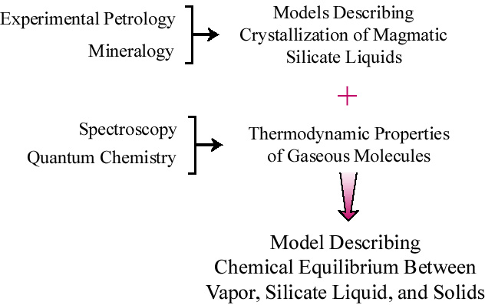
Experimental Basis of Chemical Models

Slide 44
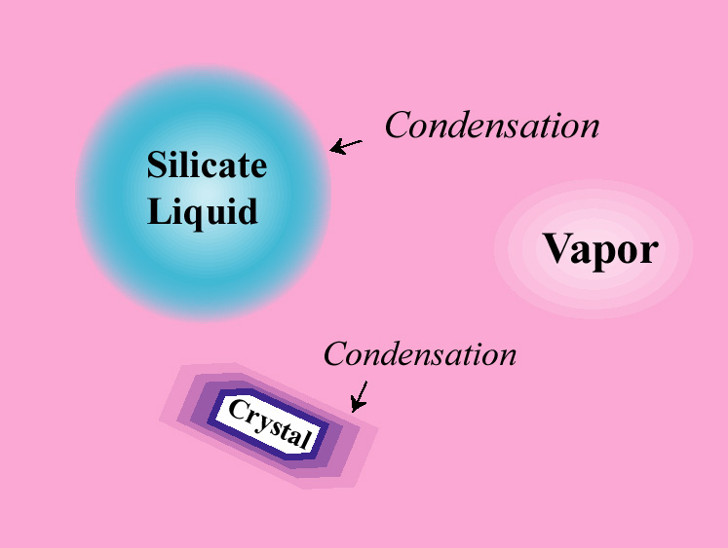

Slide 45
Equilibrium Condensation of a Vapor of Solar Composition

Slide 46
Allende (CV3)

Slide 47
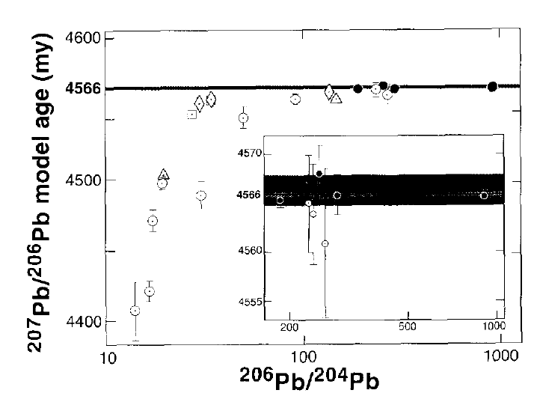
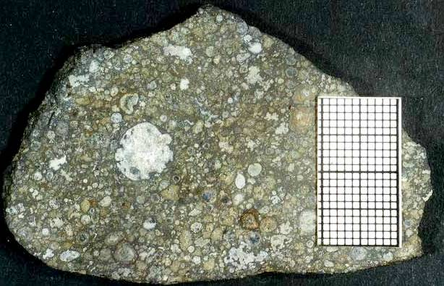
Ages of Allende Inclusions
Five tons of the Allende carbonaceous chondrite (CV3) fell in Mexico in 1969.
Pb-Pb ages of Allende
refractory (Ca-Al rich) inclusions (CAIs) as function of ²⁰⁶Pb/²⁰⁴Pb ratios > diagram (c. 1995)
CAIs are the earliest condensates of the solar nebula
= oldest solid material of the solar system
From: Allègre et al., 1995, The age of the Earth. Geochim. Cosmochim. Acta 59, 1445-1456
Notes:
47

Slide 48
Oldest Components of Chondritic Meteorites
are Ca-, Al-rich Inclusions
Axtell (CV3): Ca-, Al-rich inclusions
are 4567.7 +/- 0.8 million years old,
by U-Pb dating

Slide 49
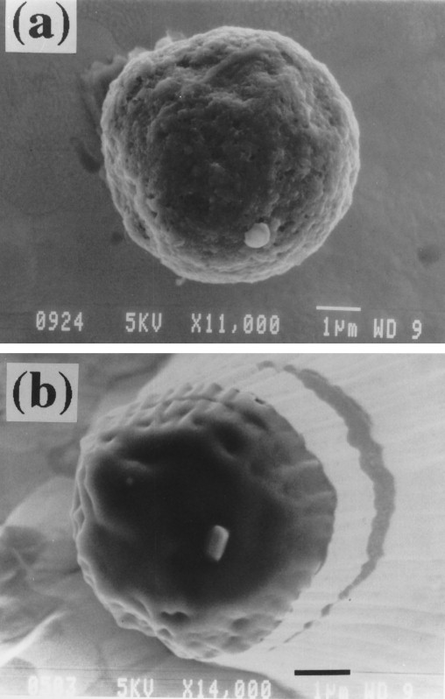
Before sputtering
Pre-Solar Grains
Scanning Electron Microscope
(SEM) images of a single
pre-solar graphite grain
Pre-solar grains:
Small grains formed around
main-sequence stars, or in
supernova explosions, and
isolated from meteorites.
Types:
nanodiamond
silicon carbide (SiC)
graphite
titanium oxide (TiO₂)
silicon nitride
spinel
silicates
1 micron
After
sputtering
TiC

Slide 50

Thank you.
a chondrule
finis.

Slide 51



Notes:
From: http://en.wikipedia.org/wiki/Lead-lead_dating

Slide 52
Hydrogen has only one proton, hence does not need a neutron to keep its nucleus together. Helium, the next element up the periodic table, does. The stable isotope of helium requires the combined nuclear force of two neutrons to keep its two protons from flying apart. ²³⁸U with 92 protons requires 146 neutrons to hold it together and even then, ²³⁸U still comes apart, with a half-life of 4.47 billion years.
Other dating methods are based on other ‘parent’-’daughter’ pairs. For example, the Strontium - Rubidium system.
⁸⁷Rb = ⁸⁷Sr + energy halflife ⁸⁷Rb ~ 4.88 x 10¹⁰ years
Suppose we want to determine the age of a rock containing Sr and Rb. We have to assume the rock is a “closed system”, i.e., no Sr or Rb has leaked into or out of the rock since the rock was formed. Then:
⁸⁷Sr_{n} = ⁸⁷Sr_{t} + the Sr that arrived by the decay of ⁸⁷Rb_{t}

